Slide 1

Application for the Data Science Fellowship Winter 2022 session
The Data Incubator
Project : Infantile obesity
By Nsiaka Meliphe Christophe Le Roy
TDI Applicant

Slide 2

Presentation Plan
Introduction
Data Presentation
Analysis done
Perspective Analysis
Conclusion
Reference

Slide 3
Introduction
Childhood obesity affects nearly 42 million children worldwide. If this trend continues, the WHO estimates that this figure will reach 70 million by 2025.
One in three children aged 6-9 years is overweight or obese in several Member States of the WHO European Region.
In France, between 20 and 25% of children are overweight and 5% of them suffer from childhood obesity.

Slide 4
Data Presentation (1/2)
A sample of children's files was entered. These were children seen during a visit to the 1st section of kindergarten in 1996-1997 in schools in Bordeaux (Gironde, France).
The sample consists of 152 children aged 3 or 4 years.

Slide 5
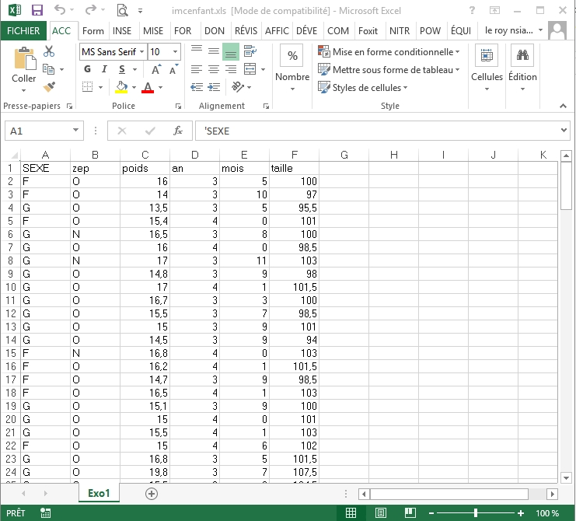
Data Presentation (2/2)

Slide 6
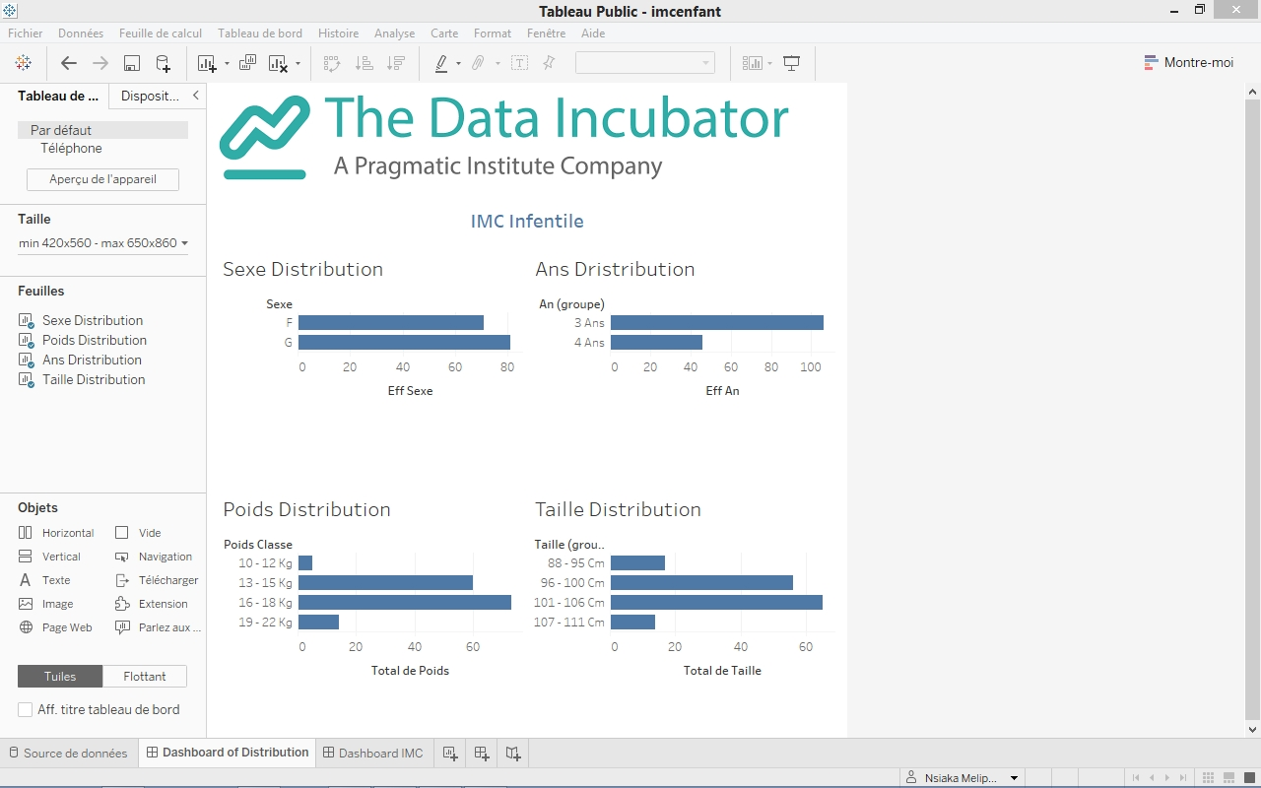
Visualization done (1/2)

Slide 7
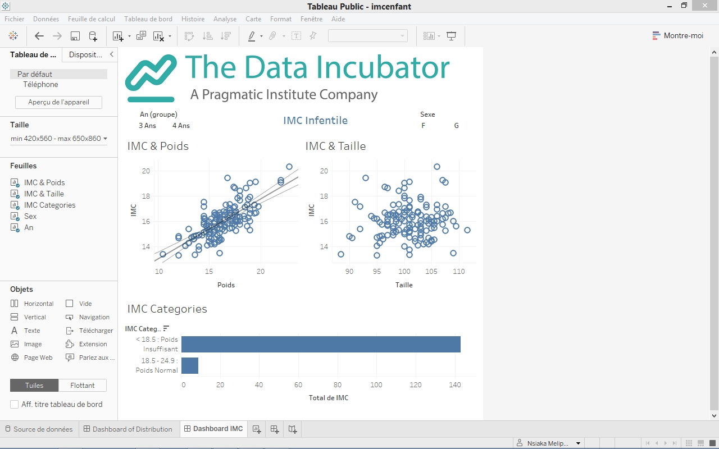
Visualization done (2/2)

Slide 8
Perspective Analysis (1/2)
Our objective is to develop some machine learning or deep learning models with Python.
We think that this infantile obesity problem is a Multi-Class Classification.

Slide 9
Perspective Analysis (2/2)
Popular algorithms that we can be used for multi-class classification include:
k-Nearest Neighbors.
Decision Trees.
Naive Bayes.
Random Forest.
Gradient Boosting.

Slide 10
Conclusion
In conclusion, with Tableau Public we are visualizing our dataset.
But for understand the infantile obesity problem and suggest solution, we will should do high analysis like machine learning and deep learning.

Slide 11
Reference
https://public.tableau.com/app/profile/nsiaka/viz/imcenfant/DashboardIMC?publish=yes
https://www.europe1.fr/sante/obesite-infantile-trois-questions-pour-mieux-la-comprendre-et-bien-la-traiter-4000422
https://sante.journaldesfemmes.fr/fiches-sante-du-quotidien/2646153-obesite-infantile-causes-chiffres-en-france-prise-en-charge/
https://www.euro.who.int/fr/media-centre/sections/press-releases/2021/high-rates-of-childhood-obesity-alarming-given-anticipated-impact-of-covid-19-pandemic
https://eco2021.com/
https://www.euro.who.int/en/health-topics/disease-prevention/nutrition/activities/who-european-childhood-obesity-surveillance-initiative-cosi

